Slide 1



Noida Institute of Engineering and Technology, Greater Noida
DECISION TREES
AND
INSTANCE BASED LEARNING
Unit: 3
Subject Name:
ACSML0401
Machine Learning Techniques
Faculty Details:
Alisha Sikri
Assistant professor
AIML
Course Details: B.Tech V-Sem

Slide 2

Faculty Profile
Noida Institute of Engineering and Technology, Greater Noida
Name: Alisha Sikri
Qualification: PhD (Pursuing)
Specialization Areas: Machine Learning, Artificial Intelligence
COURSE | BOARD/UNIVERSITY | YEAR OF PASSING
PhD | SRM University, NCR | Pursuing
M.Tech | DCRUST University, Murthal | 2016
B.Tech | MDU, Rohtak | 2014

Slide 3

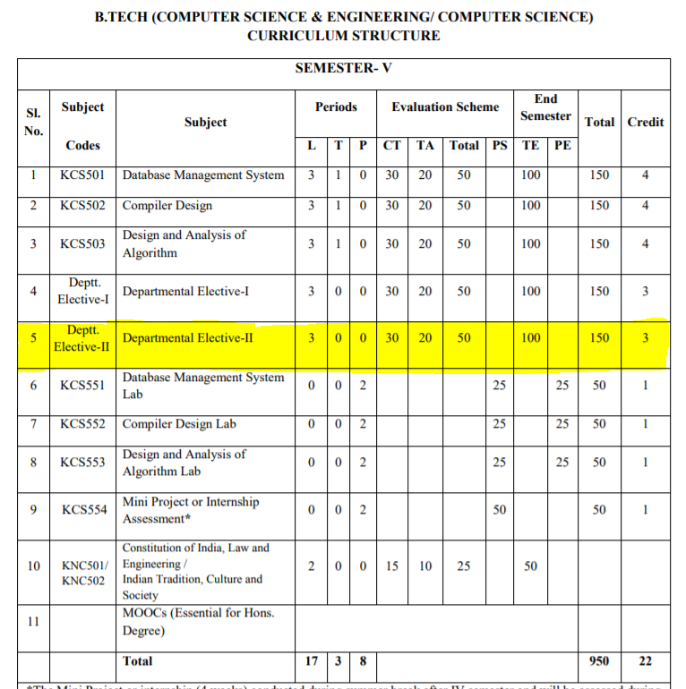
Evaluation Scheme

Slide 4
Syllabus
Unit-I : Introduction-
Learning, Types of Learning, Well defined learning problems, Designing a Learning System, History of ML, Introduction of Machine Learning Approaches – (Artificial Neural Network, Clustering, Reinforcement Learning, Decision Tree Learning, Bayesian networks, Support Vector Machine, Genetic Algorithm), Issues in Machine Learning and Data Science Vs Machine Learning
Unit-II : REGRESSION:
Linear Regression and Logistic Regression BAYESIAN LEARNING - Bayes theorem, Concept learning, Bayes Optimal Classifier, Naïve Bayes classifier, Bayesian belief networks, EM algorithm. SUPPORT VECTOR MACHINE: Introduction, Types of support vector kernel – (Linear kernel, polynomial kernel,and Gaussian kernel), Hyperplane – (Decision surface), Properties of SVM, and Issues in SVM.
Unit-III : DECISION TREE LEARNING - Decision tree learning algorithm, Inductive bias, Inductive inference with decision trees, Entropy and information theory, Information gain, ID-3 Algorithm, Issues in Decision tree learning. INSTANCE-BASED LEARNING – k-Nearest Neighbor Learning, Locally Weighted Regression, Radial basis function networks, Case-based learning.

Slide 5
Syllabus
Unit-IV : ARTIFICIAL NEURAL NETWORKS –
Perceptron’s, Multilayer perceptron, Gradient descent and the Delta rule, Multilayer networks, Derivation of Back-propagation Algorithm, Generalization, Unsupervised Learning – SOM Algorithm and its variant; DEEP LEARNING - Introduction, concept of convolutional neural network , Types of layers – (Convolutional Layers , Activation function , pooling , fully connected) , Concept of Convolution (1D and 2D) layers, Training of network, Case study of CNN for eg on Diabetic Retinopathy, Building a smart speaker, Self-deriving car etc..
Unit-V : REINFORCEMENT LEARNING–Introduction to Reinforcement Learning , Learning Task, Example of Reinforcement Learning in Practice, Learning Models for Reinforcement – (Markov Decision process , Q Learning - Q Learning function, Q Learning Algorithm ), Application of Reinforcement Learning, Introduction to Deep Q Learning. GENETIC ALGORITHMS: Introduction, Components, GA cycle of reproduction, Crossover, Mutation, Genetic Programming, Models of Evolution and Learning, Applications

Slide 6
Branch wise Application
Virtual Personal Assistants
Predictions while Commuting
Videos Surveillance
Social Media Services
Email Spam and Malware Filtering
Online Customer Support
Search Engine Result Refining
Product Recommendations
Online Fraud Detection

Slide 7
Course Objectives
This course will serve as a comprehensive introduction to various topics in machine learning
To introduce students to the basic concepts and techniques of Machine Learning.
To become familiar with regression methods, classification methods, clustering methods.
To introduce the concept of Decision Tree Learning and Instance-based Learning
To become familiar with Artificial Neural Networks and Deep Learning
To introduce the concept of Reinforcement Learning and Genetic Algorithms

Slide 8
Course Outcomes
At the end of the course, the student should be able to
COURSE OUTCOME NO | COURSE OUTCOMES
CO1 | To understand the need for machine learning for various problem solving
CO2 | To understand a wide variety of learning algorithms and how to evaluate models generated from data
CO3 | To understand the latest trends in machine learning
CO4 | To design appropriate machine learning algorithms and apply the algorithms to a real-world problems
CO5 | To optimize the models learned and report on the expected accuracy that can be achieved by applying the models

Slide 9
Course Outcomes
1. Engineering knowledge
2. Problem analysis
3. Design/development of solutions
4. Conduct investigations of complex problems
5. Modern tool usage
6. The engineer and society
7. Environment and sustainability
8. Ethics
9. Individual and team work
10. Communication
11. Project management and finance
12. Life-long learning

Slide 10
CO-PO Mapping
CO MAPPING WITH PO
CO. No. | PO1 | PO2 | PO 3 | PO 4 | PO 5 | PO 6 | PO 7 | PO 8 | PO 9 | PO 10 | PO 11 | PO 12
1 | 3 | 3 | 3 | 1 |  |  |  |  | 1 |  |  | 2
2 | 3 | 3 | 3 | 1 |  |  |  |  | 1 |  |  | 1
3 | 3 | 3 | 3 | 1 |  | 1 |  |  | 1 |  |  | 1
4 | 3 | 3 | 3 | 1 |  |  |  |  | 1 |  |  | 2
5 | 3 | 3 | 3 | 2

Slide 11
Program Specific Outcome (PSO)
On successful completion of graduation degree, The computer Science & Engineering graduates will be able to:
PSO1: identify, analyze real world problems and design their ethical solutions using artificial intelligence, robotics, virtual/augmented reality, data analytics, block chain technology, and cloud computing.
PSO2: design and develop the hardware sensor devices and related interfacing software systems for solving complex engineering problems.
PSO 3: understand inter-disciplinary computing techniques and to apply them in the design of advanced computing.
PSO 4: conduct investigation of complex problem with the help of technical, managerial, leadership qualities, and modern engineering tools provided by industry sponsored laboratories.

Slide 12
CO-PSO Mapping
CO MAPPING WITH PSO
CO/PSO | POS1 | POS2 | POS3 | POS4
CO 1 | 3 | 1 | 1 | -
CO 2 | 3 | 2 | - | -
CO 3 | 3 | 2 | - | -
CO 4 | 3 | 2 | 2 | 1
CO 5 | 3 | 2 | 1 | -

Slide 13
PEOs
PEO 1: To have an excellent scientific and engineering breadth so as to comprehend, analyze, design and provide sustainable solutions for real-life problems using state-of-the-art technologies.
PEO 2: To have a successful career in industries, to pursue higher studies or to support entrepreneurial endeavors and to face the global challenges.
PEO 3:To have an effective communication skills, professional attitude, ethical values and a desire to learn specific knowledge in emerging trends, technologies for research, innovation and product development and contribution to society.
PEO 4: To have life-long learning for up-skilling and re-skilling for successful professional career as engineer, scientist, entrepreneur and bureaucrat for betterment of society.

Slide 14
CO-PSO Mapping
CO. NO. | PSO1 | PSO2 | PSO3 | PSO4
1 | 1 | 2
2 | 1 | 2 | 1 | 1
3 | 2 | 1 | 1 | 2
4 | 1 | 1 | 1 | 2
5 | 1 | 1 | 1

Slide 15
Result Analysis
MLT(KCS-055)
Subject wise result | 95.62
Faculty wise result | 92.65

Slide 16
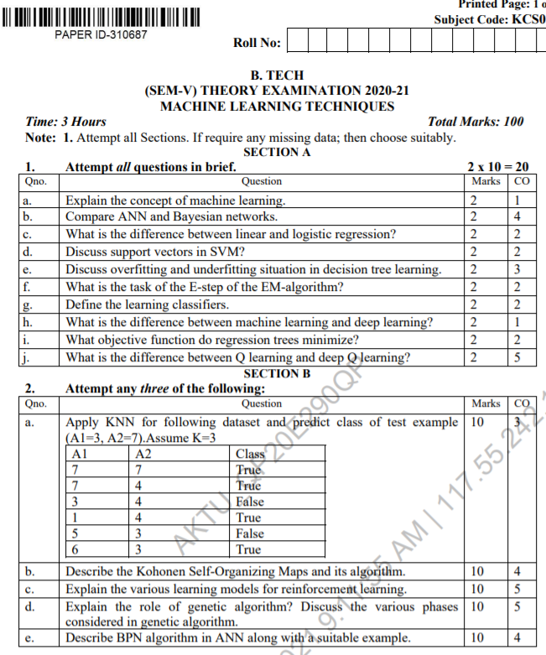
End Sem Question Papers Format

Slide 17
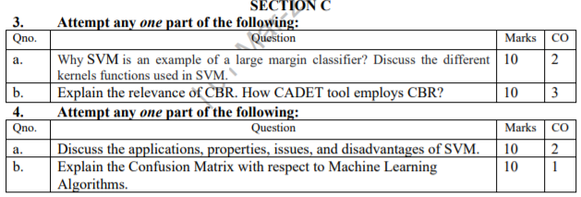
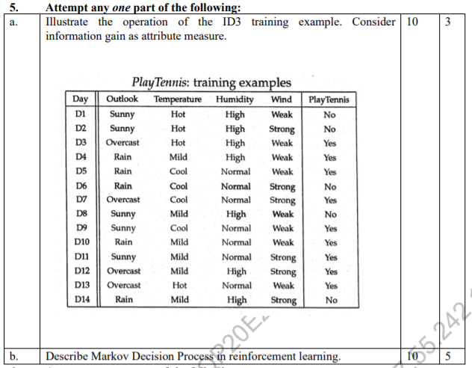
End Sem Question Papers Format

Slide 18
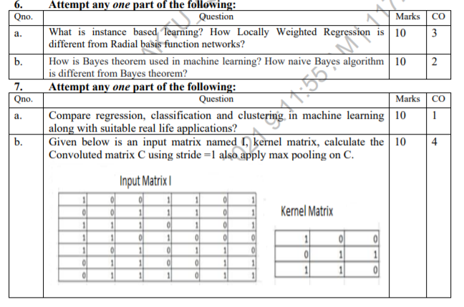
End Sem Question Papers Format

Slide 19
Prerequisite
To get started with Machine Learning you must be familiar with the following
concepts:
Algebra
variables, coefficients, and functions
linear equations such as y=b+w1x1+w2x2
logarithms, and logarithmic equations such as y=ln(1+ez)
sigmoid function
Linear algebra
tensor and tensor rank
matrix multiplication

Slide 20
Prerequisite
Trigonometry
Tan h (discussed as an activation function; no prior knowledge needed)
Calculus (optional, for advanced topics)
concept of a derivative (you won't have to actually calculate derivatives)
gradient or slope
partial derivatives (which are closely related to gradients)
chain rule (for a full understanding of the backpropagation algorithm for training neural networks)

Slide 21
Pre-requisite
Programming language:
It is essential to know programming languages like R and Python in order to implement the whole Machine Learning process. Python and R both provide in-built libraries that make it very easy to implement Machine Learning algorithms.

Slide 22
Contents
DECISION TREE LEARNING
Decision tree learning algorithm
Inductive bias
Inductive inference with decision trees
Entropy and information theory
Information gain
ID-3 Algorithm
Issues in Decision tree learning.

Slide 23
Contents
INSTANCE-BASED LEARNING
k-Nearest Neighbour Learning
Locally Weighted Regression
Radial basis function networks
Case-based learning

Slide 24
Objectives of Unit
Mainly the unit’s objectives are:
To introduce students to the concepts of decision trees: Recursive induction of decision trees by Picking the best splitting attribute: entropy and information gain.
Searching for simple trees and computational complexity, Occam's razor, Overfitting, noisy data, and pruning.

Slide 25
Unit Outcomes
At the end of this course the students should be able to design and implement machine learning solutions to classification, regression, problems.
Construct learning algorithms which involves linear regression with a comprehension of regularization, bias-variance and evidence approximation.
Able to solve the classification problem based on probability theory
Able to apply SVM.

Slide 26
Mapping with CO
DECISION TREE LEARNING
Decision tree learning algorithm(CO3)
Inductive bias(CO3)
Inductive inference with decision trees(CO3)
Entropy and information theory(CO3)
Information gain (CO3)
ID-3 Algorithm(CO3)
Issues in Decision tree learning. (CO3)
INSTANCE-BASED LEARNING(CO3)

Slide 27
Decision Tree
Decision Tree is a Supervised learning technique that can be used for both classification and Regression problems, but mostly it is preferred for solving Classification problems.
It is a tree-structured classifier, where internal nodes represent the features of a dataset, branches represent the decision rules and each leaf node represents the outcome.
In a Decision tree, there are two nodes, which are the Decision Node and Leaf Node. Decision nodes are used to make any decision and have multiple branches, whereas Leaf nodes are the output of those decisions and do not contain any further branches.
The decisions or the test are performed on the basis of features of the given dataset.

Slide 28
Decision Tree(CONT’D)
It is a graphical representation for getting all the possible solutions to a problem/decision based on given conditions.
It is called a decision tree because, similar to a tree, it starts with the root node, which expands on further branches and constructs a tree-like structure.
In order to build a tree, we use the CART algorithm, which stands for Classification and Regression Tree algorithm.
A decision tree simply asks a question, and based on the answer (Yes/No), it further split the tree into subtrees.
NOTE: A decision tree can contain categorical data (YES/NO) as well as numeric data.

Slide 29

Decision Tree(CONT’D)

Slide 30
ID3 ALGORITHM
Iterative Dichotomiser 3 or commonly known as ID3. ID3 was invented by Ross Quinlan.
It is a classification algorithm that follows a greedy approach of building a decision tree by selecting a best attribute that yields maximum Information Gain (IG) or minimum Entropy (H).
Decision Tree is most effective if the problem characteristics look like the following points:
1) Instances can be described by attribute-value pairs. 2) Target function is discrete-valued.

Slide 31

ID3 ALGORITHM
“Entropy is the measurement of homogeneity.
It returns us the information about an arbitrary dataset that how impure/non-homogeneous the data set is.”
Given a collection of examples/dataset S, containing positive and negative examples of some target concept, the entropy of S relative to this boolean classification is-

Slide 32
ID3 ALGORITHM
When we use a node in a decision tree to partition the training instances into smaller subsets the entropy changes. Information gain is a measure of this change in entropy.
Information Gain = entropy(parent) – [average entropy(children)]

Slide 33
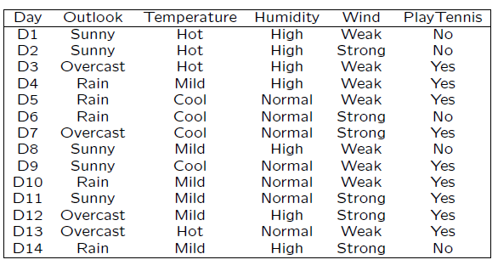
Example: Decision Tree for Play Tennis

Slide 34
Example: Decision Tree for Play Tennis
Here, dataset is of binary classes(yes and no), where 9 out of 14 are "yes" and 5 out of 14 are "no".
Complete entropy of dataset is –
H(S) = - p(yes) * log2(p(yes)) - p(no) * log2(p(no))
= - (9/14) * log2(9/14) - (5/14) * log2(5/14)
= - (-0.41) - (-0.53)
= 0.94

Slide 35
Example: Decision Tree for Play Tennis
First Attribute - Outlook
Categorical values - sunny, overcast and rain
H(Outlook=sunny) = -(2/5)*log(2/5)-(3/5)*log(3/5) =0.971
H(Outlook=rain) = -(3/5)*log(3/5)-(2/5)*log(2/5) =0.971
H(Outlook=overcast) = -(4/4)*log(4/4)-0 = 0
Average Entropy Information for Outlook -
I(Outlook) = p(sunny) * H(Outlook=sunny) + p(rain) * H(Outlook=rain) + p(overcast) * H(Outlook=overcast)
= (5/14)*0.971 + (5/14)*0.971 + (4/14)*0
= 0.693
Information Gain = H(S) - I(Outlook)
= 0.94 - 0.693
= 0.247

Slide 36
Example: Decision Tree for Play Tennis
Second Attribute - Temperature
Categorical values - hot, mild, cool
H(Temperature=hot) = -(2/4)*log(2/4)-(2/4)*log(2/4) = 1
H(Temperature=cool) = -(3/4)*log(3/4)-(1/4)*log(1/4) = 0.811
H(Temperature=mild) = -(4/6)*log(4/6)-(2/6)*log(2/6) = 0.9179
Average Entropy Information for Temperature -
I(Temperature) = p(hot)*H(Temperature=hot) + p(mild)*H(Temperature=mild) + p(cool)*H(Temperature=cool)
= (4/14)*1 + (6/14)*0.9179 + (4/14)*0.811
= 0.9108
Information Gain = H(S) - I(Temperature)
= 0.94 - 0.9108
= 0.0292

Slide 37
Example: Decision Tree for Play Tennis
Third Attribute - Humidity
Categorical values - high, normal
H(Humidity=high) = -(3/7)*log(3/7)-(4/7)*log(4/7) = 0.983
H(Humidity=normal) = -(6/7)*log(6/7)-(1/7)*log(1/7) = 0.591
Average Entropy Information for Humidity -
I(Humidity) = p(high)*H(Humidity=high) + p(normal)*H(Humidity=normal)
= (7/14)*0.983 + (7/14)*0.591
= 0.787
Information Gain = H(S) - I(Humidity)
= 0.94 - 0.787
= 0.153

Slide 38
Example: Decision Tree for Play Tennis
Fourth Attribute - Wind
Categorical values - weak, strong
H(Wind=weak) = -(6/8)*log(6/8)-(2/8)*log(2/8) = 0.811
H(Wind=strong) = -(3/6)*log(3/6)-(3/6)*log(3/6) = 1
Average Entropy Information for Wind -
I(Wind) = p(weak)*H(Wind=weak) + p(strong)*H(Wind=strong)
= (8/14)*0.811 + (6/14)*1
= 0.892
Information Gain = H(S) - I(Wind)
= 0.94 - 0.892
= 0.048

Slide 39
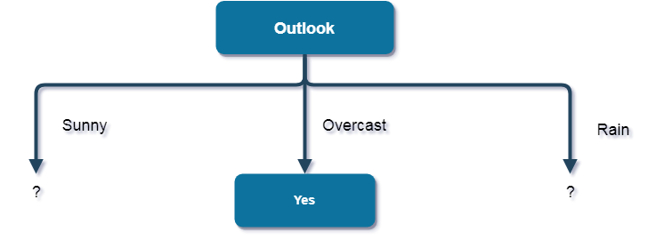
Example: Decision Tree for Play Tennis
Here, the attribute with maximum information gain is Outlook. So, the decision tree built so far -
Here, when Outlook == overcast, it is of pure class(Yes).
Now, we have to repeat same procedure for the data with rows consist of Outlook value as Sunny and then for Outlook value as Rain

Slide 40
Example: Decision Tree for Play Tennis
Now, finding the best attribute for splitting the data with Outlook=Sunny values{ Dataset rows = [1, 2, 8, 9, 11]
Complete entropy of Sunny is –
H(S) = - p(yes) * log2(p(yes)) - p(no) * log2(p(no))
= - (2/5) * log2(2/5) - (3/5) * log2(3/5)
= 0.971

Slide 41
Example: Decision Tree for Play Tennis
First Attribute - Temperature
Categorical values - hot, mild, cool
H(Sunny, Temperature=hot) = -0-(2/2)*log(2/2) = 0
H(Sunny, Temperature=cool) = -(1)*log(1)- 0 = 0
H(Sunny, Temperature=mild) = -(1/2)*log(1/2)-(1/2)*log(1/2) = 1
Average Entropy Information for Temperature -
I(Sunny, Temperature) = p(Sunny, hot)*H(Sunny, Temperature=hot) + p(Sunny, mild)*H(Sunny, Temperature=mild) + p(Sunny, cool)*H(Sunny, Temperature=cool)
= (2/5)*0 + (1/5)*0 + (2/5)*1
= 0.4
Information Gain = H(Sunny) - I(Sunny, Temperature)
= 0.971 - 0.4
= 0.571

Slide 42
Example: Decision Tree for Play Tennis
Second Attribute - Humidity
Categorical values - high, normal
H(Sunny, Humidity=high) = - 0 - (3/3)*log(3/3) = 0
H(Sunny, Humidity=normal) = -(2/2)*log(2/2)-0 = 0
Average Entropy Information for Humidity -
I(Sunny, Humidity) = p(Sunny, high)*H(Sunny, Humidity=high) + p(Sunny, normal)*H(Sunny, Humidity=normal)
= (3/5)*0 + (2/5)*0
= 0
Information Gain = H(Sunny) - I(Sunny, Humidity)
= 0.971 – 0
= 0.971

Slide 43
Example: Decision Tree for Play Tennis
Third Attribute - Wind
Categorical values - weak, strong
H(Sunny, Wind=weak) = -(1/3)*log(1/3)-(2/3)*log(2/3) = 0.918
H(Sunny, Wind=strong) = -(1/2)*log(1/2)-(1/2)*log(1/2) = 1
Average Entropy Information for Wind -
I(Sunny, Wind) = p(Sunny, weak)*H(Sunny, Wind=weak) + p(Sunny, strong)*H(Sunny, Wind=strong)
= (3/5)*0.918 + (2/5)*1
= 0.9508
Information Gain = H(Sunny) - I(Sunny, Wind)
= 0.971 - 0.9508
= 0.0202

Slide 44
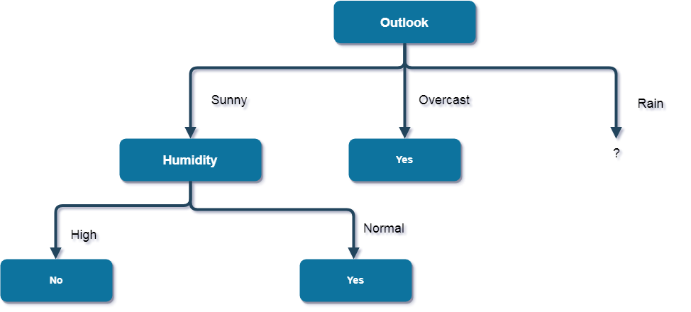
Example: Decision Tree for Play Tennis
Here, the attribute with maximum information gain is Humidity. So, the decision tree built so far -
Here, when Outlook = Sunny and Humidity = High, it is a pure class of category "no". And When Outlook = Sunny and Humidity = Normal, it is again a pure class of category "yes". Therefore, we don't need to do further calculations

Slide 45
Example: Decision Tree for Play Tennis
Now, finding the best attribute for splitting the data with Outlook=Sunny values { Dataset rows = [4, 5, 6, 10, 1]}
Complete entropy of Rain is -
H(S) = - p(yes) * log2(p(yes)) - p(no) * log2(p(no))
= - (3/5) * log(3/5) - (2/5) * log(2/5)
= 0.971

Slide 46
Example: Decision Tree for Play Tennis
First Attribute – Temperature
Categorical values - mild, cool
H(Rain, Temperature=cool) = -(1/2)*log(1/2)- (1/2)*log(1/2) = 1
H(Rain, Temperature=mild) = -(2/3)*log(2/3)-(1/3)*log(1/3) = 0.918
Average Entropy Information for Temperature -
I(Rain, Temperature) = p(Rain, mild)*H(Rain, Temperature=mild) + p(Rain, cool)*H(Rain, Temperature=cool)
= (2/5)*1 + (3/5)*0.918
= 0.9508
Information Gain = H(Rain) - I(Rain, Temperature)
= 0.971 - 0.9508
= 0.0202

Slide 47
Example: Decision Tree for Play Tennis
Second Attribute - Wind
Categorical values - weak, strong
H(Wind=weak) = -(3/3)*log(3/3)-0 = 0
H(Wind=strong) = 0-(2/2)*log(2/2) = 0
Average Entropy Information for Wind -
I(Wind) = p(Rain, weak)*H(Rain, Wind=weak) + p(Rain, strong)*H(Rain, Wind=strong)
= (3/5)*0 + (2/5)*0
= 0
Information Gain = H(Rain) - I(Rain, Wind)
= 0.971 - 0
= 0.971

Slide 48
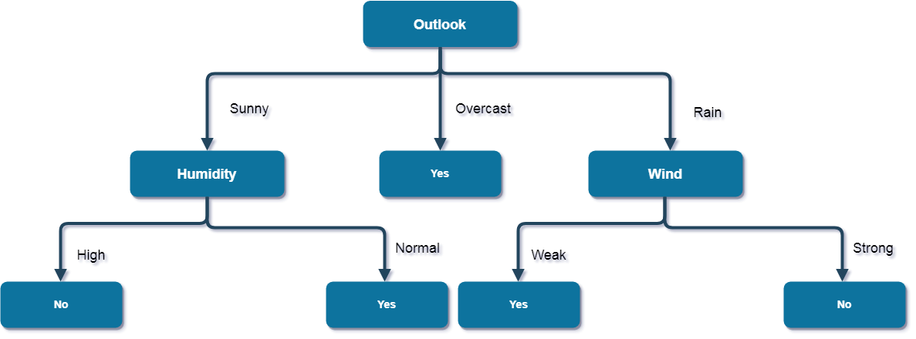
Example: Decision Tree for Play Tennis
Here, the attribute with maximum information gain is Wind. So, the decision tree built so far -

Slide 49
EXAMPLE 2: PRACTICE
For the medical diagnosis data , create a decision tree:
Soar Throat | Fever | Swallen Glands | Congestion | Headache | Diagnosis
YES | YES | YES | YES | YES | STREP THROAT
NO | NO | NO | YES | YES | ALLERGY
YES | YES | NO | YES | NO | COLD
YES | NO | YES | NO | NO | STREP THROAT
NO | YES | NO | YES | NO | COLD
NO | NO | NO | YES | NO | ALLERGY
NO | NO | YES | NO | NO | STREP THROAT
YES | NO | NO | YES | YES | ALLERGY
NO | YES | NO | YES | YES | COLD
YES | NO | NO | YES | YES | COLD

Slide 50
INDUCTIVE BIAS IN DECISION TREE
The inductive bias (also known as learning bias) of a learning algorithm is the set of assumptions that the learner uses to predict outputs of given inputs that it has not encountered
• Inductive Bias in ID3
– Approximate inductive bias of ID3
• Shorter trees are preferred over larger tress
• BFS-ID3
– A closer approximation to the inductive bias of ID3
• Shorter trees are preferred over longer trees. Trees that place high information gain attributes close to the root are preferred over those that do not.

Slide 51
DIFFERENCE BETWEEN ID3 AND CANDIDATE _ELIMINATION
ID3
– Searches a complete hypothesis space incompletely
– Inductive bias is solely a consequence of the ordering of hypotheses by its search strategy
Candidate-Elimination
– Searches an incomplete hypothesis space completely
– Inductive bias is solely a consequence of the expressive power of its hypothesis representation

Slide 52
ISSUES IN DECISION TREE
Practical issues in learning decision trees include
Determining how deeply to grow the decision tree,
Handling continuous attributes,
Choosing an appropriate attribute selection measure,
Handling training data with missing attribute values,
Handling attributes with differing costs, and
Improving computational efficiency.

Slide 53
INSTANCE BASED LEARNING
The Machine Learning systems which are categorized as instance-based learning are the systems that learn the training examples by heart and then generalizes to new instances based on some similarity measure.
It is called instance-based because it builds the hypotheses from the training instances.
It is also known as memory-based learning or lazy-learning.
The time complexity of this algorithm depends upon the size of training data. The worst-case time complexity of this algorithm is O (n), where n is the number of training instances.

Slide 54
INSTANCE BASED LEARNING
Some of the instance-based learning algorithms are :
K Nearest Neighbor (KNN)
Self-Organizing Map (SOM)
Learning Vector Quantization (LVQ)
Locally Weighted Learning (LWL)

Slide 55
INSTANCE BASED LEARNING(CONT’d)
Advantages:
Instead of estimating for the entire instance set, local approximations can be made to the target function.
This algorithm can adapt to new data easily, one which is collected as we go.
Disadvantages:
Classification costs are high
Large amount of memory required to store the data, and each query involves starting the identification of a local model from scratch.

Slide 56
K-NEAREST NEIGHBHOR(KNN) LEARNING
K-Nearest Neighbor is one of the simplest Machine Learning algorithms based on Supervised Learning technique.
K-NN algorithm assumes the similarity between the new case/data and available cases and put the new case into the category that is most similar to the available categories.
K-NN algorithm stores all the available data and classifies a new data point based on the similarity. This means when new data appears then it can be easily classified into a well suite category by using K- NN algorithm.
K-NN algorithm can be used for Regression as well as for Classification but mostly it is used for the Classification problems.

Slide 57
K-NEAREST NEIGHBHOR(KNN) LEARNING
K-NN is a non-parametric algorithm, which means it does not make any assumption on underlying data.
It is also called a lazy learner algorithm because it does not learn from the training set immediately instead it stores the dataset and at the time of classification, it performs an action on the dataset.
KNN algorithm at the training phase just stores the dataset and when it gets new data, then it classifies that data into a category that is much similar to the new data.

Slide 58
KNN ALGORITHM
The K-NN working can be explained on the basis of the below algorithm:
Step-1: Select the number K of the neighbors
Step-2: Calculate the Euclidean distance of K number of neighbors
Step-3: Take the K nearest neighbors as per the calculated Euclidean distance.
Step-4: Among these k neighbors, count the number of the data points in each category.
Step-5: Assign the new data points to that category for which the number of the neighbor is maximum.
Step-6: Our model is ready.

Slide 59
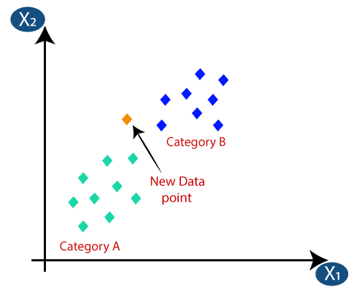
WORKING OF KNN
Suppose we have a new data point and we need to put it in the required category. Consider the below image:

Slide 60
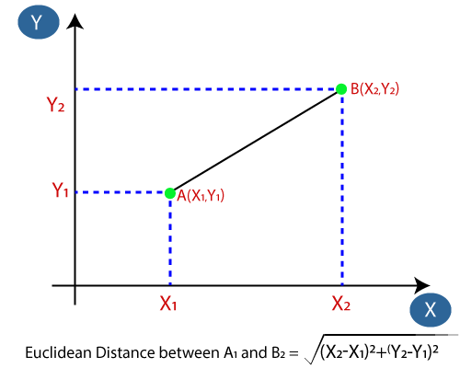
WORKING OF KNN
Firstly, we will choose the number of neighbors, so we will choose the k=5.
Next, we will calculate the Euclidean distance between the data points. The Euclidean distance is the distance between two points, which we have already studied in geometry. It can be calculated as:

Slide 61
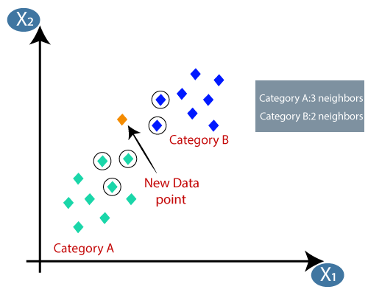
WORKING OF KNN
By calculating the Euclidean distance we got the nearest neighbors, as three nearest neighbors in category A and two nearest neighbors in category B. Consider the below image:
As we can see the 3 nearest neighbors are from category A, hence this new data point must belong to category

Slide 62
PROS AND CONS OF KNN
Advantages of KNN Algorithm:
It is simple to implement.
It is robust to the noisy training data
It can be more effective if the training data is large.
Disadvantages of KNN Algorithm:
Always needs to determine the value of K which may be complex some time.
The computation cost is high because of calculating the distance between the data points for all the training samples.

Slide 63
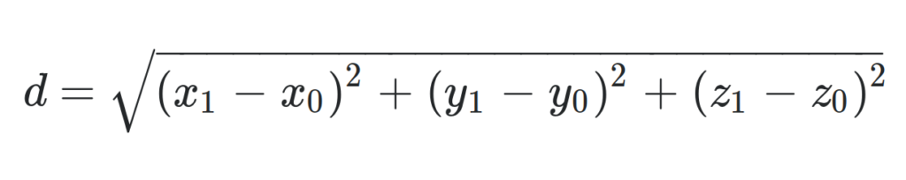
NUMERICAL ON KNN
Perform KNN Classification Algorithm on the following data set and predict the class for x (P1=3 and P2=7), where k=3
P1 | P2 | Class
7 | 7 | False
7 | 4 | False
1 | 4 | True
3 4 True
Euclidean Distance =

Slide 64
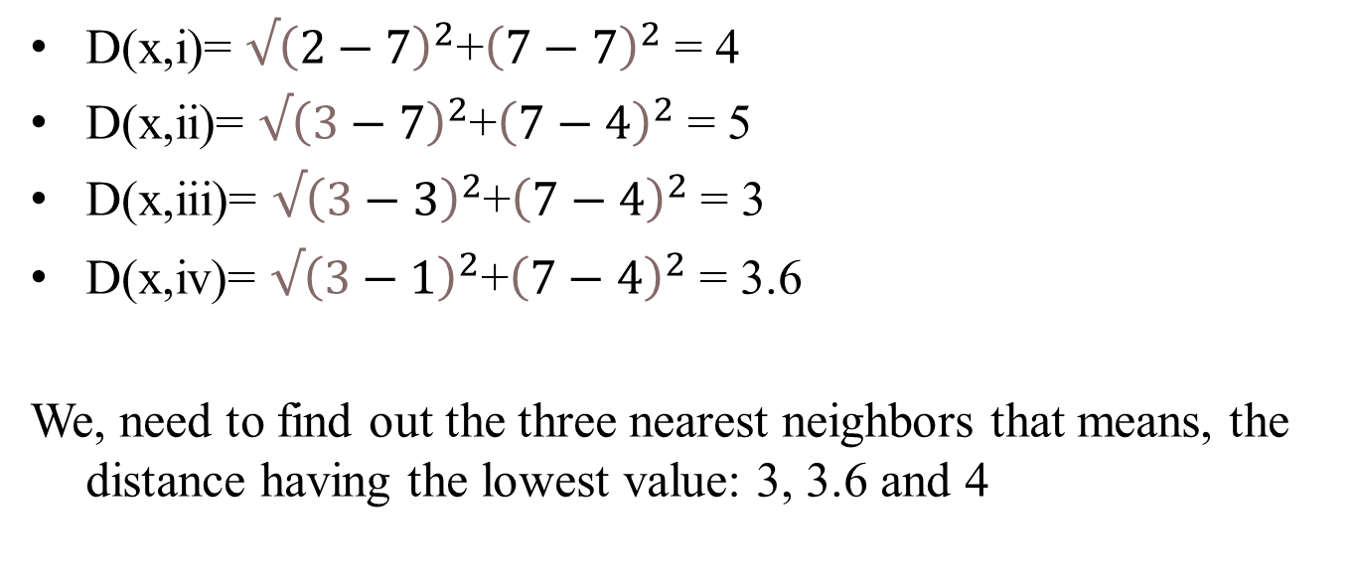
NUMERICAL ON KNN
D(x,i)= ${√\left(2−7\right)}^{2}$+${\left(7−7\right)}^{2}$ = 4
D(x,ii)= ${√\left(3−7\right)}^{2}$+${\left(7−4\right)}^{2}$ = 5
D(x,iii)= ${√\left(3−3\right)}^{2}$+${\left(7−4\right)}^{2}$ = 3
D(x,iv)= ${√\left(3−1\right)}^{2}$+${\left(7−4\right)}^{2}$ = 3.6
We, need to find out the three nearest neighbors that means, the distance having the lowest value: 3, 3.6 and 4
TRUE
TRUE
FALSE
Thus, X(p1= 2 and p2=7) will belong to class True .

Slide 65
WHY KNN IS NON-PARAMETRIC?
Non-parametric means not making any assumptions on the underlying data distribution. Non-parametric methods do not have fixed numbers of parameters in the model. Similarly in KNN, model parameters actually grows with the training data set - you can imagine each training case as a "parameter" in the model.

Slide 66
PRACTICE NUMERICAL ON KNN
Suppose we have height, weight and T-shirt size of some customers and we need to predict the T-shirt size of a new customer given only height and weight information we have. Data including height, weight and T-shirt size information is shown below -
Height (in cms) | Weight (in kgs) | T Shirt Size
158 | 58 | M
158 | 59 | M
158 | 63 | M
160 | 59 | M
160 | 60 | M
163 | 60 | M
163 | 61 | M
160 | 64 | L
163 | 64 | L
165 | 61 | L
165 | 62 | L
165 | 65 | L
168 | 62 | L
168 | 63 | L
168 | 66 | L
170 | 63 | L
170 | 64 | L
170 | 68 | L

Slide 67
PROBLEMS IN LINEAR REGRESSION
One of the problems in liner regression is that it tries to fit a constant line to you data once the model was created.
Such behaviour might be okay when your data follows linear pattern and does not have much noise.
However, when the data set is not linear, linear regression tends to under fit the training data.

Slide 68
LOCALLY WEIGHTED REGRESSION
Model-based methods, such as neural networks and the mixture of Gaussians, use the data to build a parameterized model.
After training, the model is used for predictions and the data are generally discarded.
In contrast, ``memory-based'' methods are non-parametric approaches that explicitly retain the training data, and use it each time a prediction needs to be made.
Locally weighted regression (LWR) is a memory-based method that performs a regression around a point of interest using only training data that are ``local'' to that point.

Slide 69
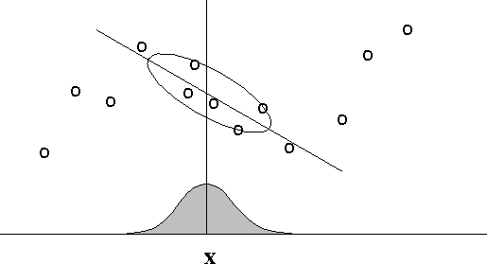
LOCALLY WEIGHTED REGRESSION
In locally weighted regression, points are weighted by proximity to the current x in question using a kernel. A regression is then computed using the weighted points.

Slide 70
CASE BASED LEARNING
Case-Based Reasoning classifiers (CBR) use a database of problem solutions to solve new problems. It stores the tuples or cases for problem-solving as complex symbolic descriptions.
HOW CBR WORKS
When a new case arrises to classify, a Case-based Reasoner(CBR) will first check if an identical training case exists.
If one is found, then the accompanying solution to that case is returned.
If no identical case is found, then the CBR will search for training cases having components that are similar to those of the new case.

Slide 71
CASE BASED LEARNING
Conceptually, these training cases may be considered as neighbours of the new case.
If cases are represented as graphs, this involves searching for subgraphs that are similar to subgraphs within the new case.
The CBR tries to combine the solutions of the neighbouring training cases to propose a solution for the new case.
If compatibilities arise with the individual solutions, then backtracking to search for other solutions may be necessary.
The CBR may employ background knowledge and problem-solving strategies to propose a feasible solution.

Slide 72
APPLICATIONS OF CBR
Problem resolution for customer service help desks, where cases describe product-related diagnostic problems.
It is also applied to areas such as engineering and law, where cases are either technical designs or legal rulings, respectively.
Medical educations, where patient case histories and treatments are used to help diagnose and treat new patients.

Slide 73
PRACTICE NUMERICALS 1
Using A KNN algorithm , predict what class of fan michelle is. Given that Michelle is a Female and age is 5. Assume k=3
NAME | AGE | GENDER | FAN
BILL | 32 | M | Rolling Stone
HENRY | 40 | M | Neither
MARY | 16 | F | Taylor Swift
TIFFNY | 14 | F | Taylor Swift
MICHAEL | 55 | M | Neither
CARLOS | 40 | M | Taylor Swift
ASHELY | 20 | F | Neither
ROBERT | 15 | M | Taylor Swift
SALLY | 55 | F | Rolling Stone
JOHN | 15 | M | Rolling Stone

Slide 74
Solution
Convert the discrete Value of Gender attribute to Numeric value. Let us assume M=0 and F=1
NAME | AGE | GENDER | DISTANCE | FAN
BILL | 32 | M=0 | 27.02 | Rolling Stone
HENRY | 40 | M=0 | 35.01 | Neither
MARY | 16 | F=1 | 11.00 | Taylor Swift
TIFFNY | 14 | F=1 | 9.00 | Taylor Swift
MICHAEL | 55 | M=0 | 50.01 | Neither
CARLOS | 40 | M=0 | 35.01 | Taylor Swift
ASHELY | 20 | F=1 | 15.00 | Neither
ROBERT | 15 | M=0 | 10.00 | Taylor Swift
SALLY | 55 | F=1 | 50.00 | Rolling Stone
JOHN | 15 | M=0 | 10.05 | Rolling Stone
Since the class Taylor Swift is most common. The KNN predict that Michelle is a Taylor Swift fan.

Slide 75
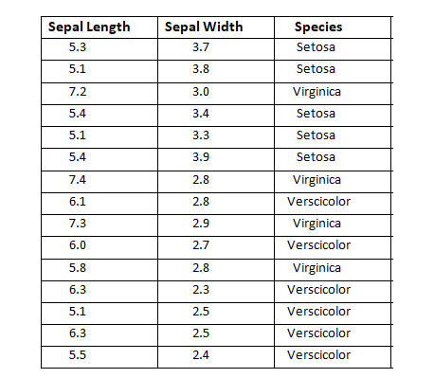
PRACTICE NUMERICALS 2
Using A KNN algorithm ,Predict new flower(sepal length=5.2 ,sepal width=3.1) . Assume k=5

Slide 76
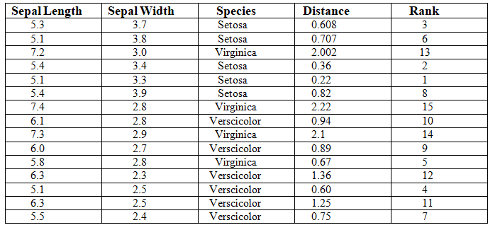
PRACTICE NUMERICALS 2
New Flower Belongs to Class SETOSA
The 3 Nearest data point belongs to Class Setosa
One Data Point Belong to Virginica
One Data Point Belong to Verscicolor

Slide 77
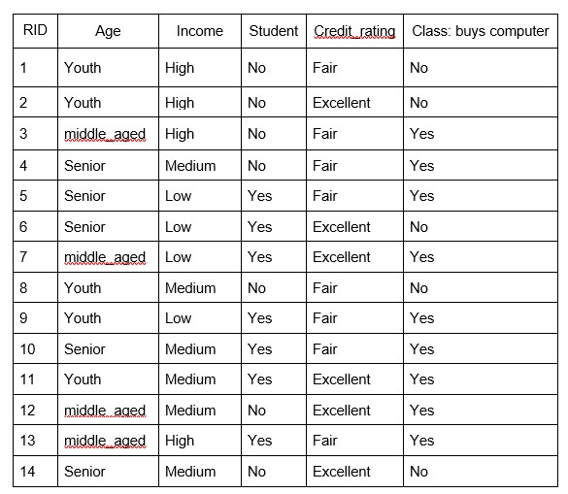
PRACTICE NUMERICALS 3
Build a decision tree using ID3 algorithm.

Slide 78
ID3 Algorithm will perform following tasks recursively
1. Create a root node for the tree 2. If all examples are positive, return leaf node ‘positive’ 3. Else if all examples are negative, return leaf node ‘negative’ 4. Calculate the entropy of current state H(S) 5. For each attribute, calculate the entropy with respect to the attribute ‘x’ denoted by H(S, x) 6. Select the attribute which has the maximum value of IG(S, x) 7. Remove the attribute that offers highest IG from the set of attributes 8. Repeat until we run out of all attributes, or the decision tree has all leaf nodes.

Slide 79
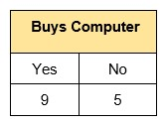
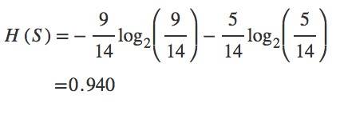
SOLUTION 3
Step 1: The initial step is to calculate H(S), the Entropy of the current state. In the above example, we can see in total there are 5 No’s and 9 Yes’s.

Slide 80
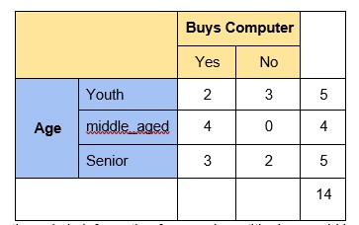
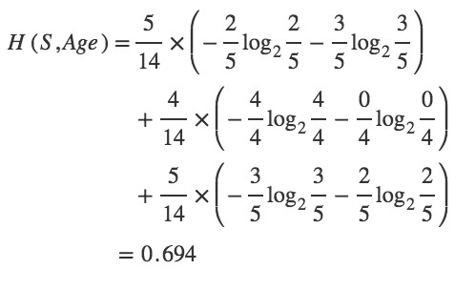
SOLUTION 3
Step 2 : The next step is to calculate H(S,x), the entropy with respect to the attribute ‘x’ for each attribute. In the above example, The expected information needed to classify a tuple in ‘S’ if the tuples are partitioned according to age is,

Slide 81
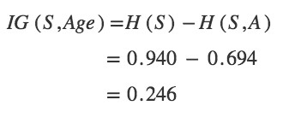
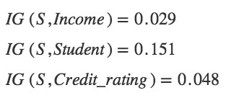
SOLUTION 3
Hence, the gain in information from such partitioning would be,
Similarly,

Slide 82
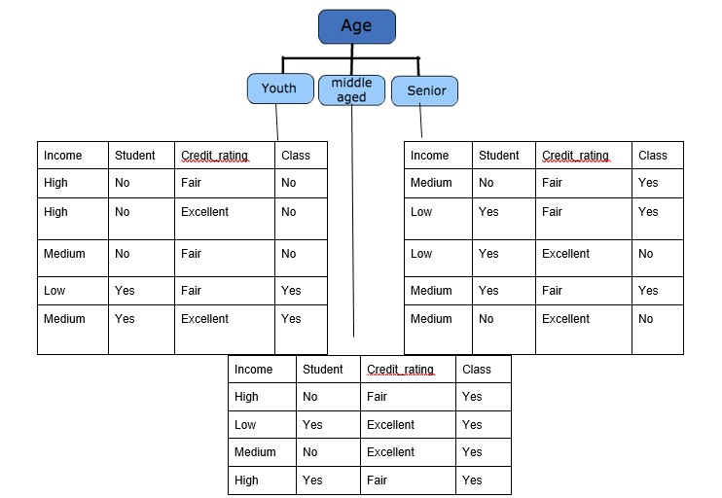
SOLUTION 3
Step 3: Choose attribute with the largest information gain, IG(S,x) as the decision node, divide the dataset by its branches and repeat the same process on every branch. Age has the highest information gain among the attributes, so Age is selected as the splitting attribute.

Slide 83
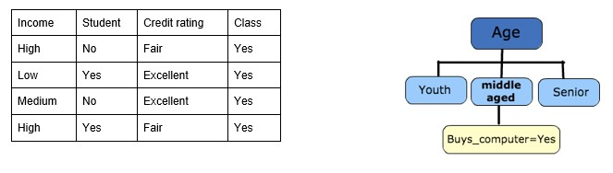
SOLUTION 3
Step 4a: A branch with an entropy of 0 is a leaf node.

Slide 84
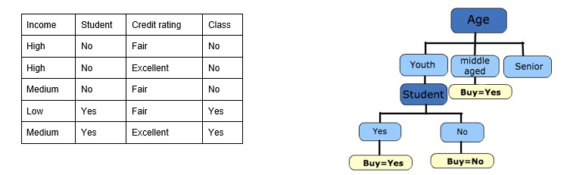
SOLUTION 3
Step 4b : A branch with entropy more than 0 needs further splitting.

Slide 85
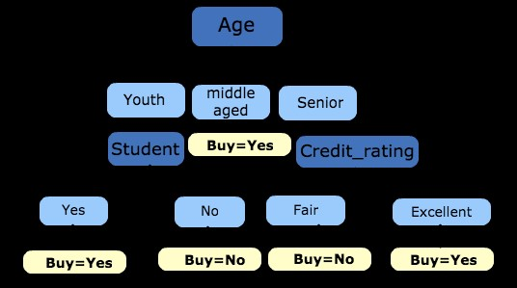
SOLUTION 3
Step 5: The ID3 algorithm is run recursively on the non-leaf branches until all data is classified.

Slide 86
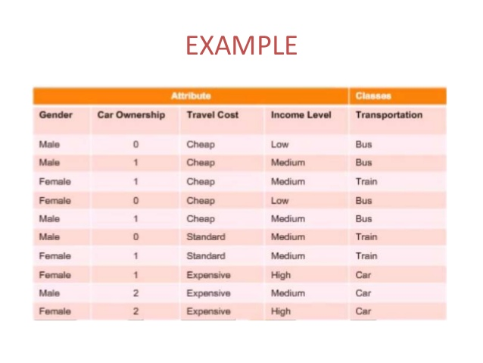
PRACTICE NUMERICALS 4
Apply ID3 Algorithm to construct the tree-structured

Slide 87
Faculty Video Links, Youtube & NPTEL Video Links and Online Courses Details
Youtube/Other Video Links:
1. Machine Learning by Prof. Balaraman ravindran, Department of computer science and engineering,IIT Madras (SWAYAM/NPTEL)
https://www.youtube.com/watch?v=fC7V8QsPBec&feature=youtu.be
2. Machine Learning by Prof. Sudeshna Sarkar, Department of computer science and engineering,IIT Kharagpur (NPTEL)
https://www.youtube.com/watch?v=EWmCkVfPnJ8&list=PLlGkyYYWOSOsGU-XARWdIFsRAJQkyBrVj&index=2
3. Machine learning UPGRAD course by IIIT,Bangalore
https://www.upgrad.com/machine-learning-ai-pgd-iiitb/

Slide 88
Daily Quiz
1. Decision trees are an algorithm for which machine learning task?
a) clustering
b) dimensionality reduction
c) classification
d) regression
2. Which error metric is most appropriate for evaluating a {0,1} classification task?
a) worst-case error
b) sum of squares error
c) entropy
d) precision and recall

Slide 89
Daily Quiz
3. A _________ is a decision support tool that uses a tree-like graph or model of decisions and their possible consequences, including chance event outcomes, resource costs, and utility. a)Decision tree b) Graphs c) Trees d) Neural Networks
4. Which of the following are the advantage/s of Decision Trees? a)Possible Scenarios can be added b) Use a white box model, If given result is provided by a model c) Worst, best and expected values can be determined for different scenarios d) All of the mentioned

Slide 90
Daily Quiz
5. Which of the following are the pros of Decision Trees?
(A). Possible Scenarios can be added
(B). Use a white-box model, If a particular result is provided by a model
(C). best, Worst and expected values can be determined for different scenarios
(D). All of these
6. Which of the following tool is considered as a decision support tool that uses a tree-like graph or model of decisions and their probable results, including utility, chance event outcomes, and resource costs.
(A). Decision tree
(B). Graphs
(C). Trees
(D). Neural Networks
(E). None of these
7. Which of the following nodes are Decision Tree nodes?
(A). Decision Nodes
(B). End Nodes
(C). Chance Nodes
(D). All of these

Slide 91
Daily Quiz
8. Decision Tree is a display of an algorithm.
(A). True
(B). False
(C). Partially true
9. We can use Decision Trees for Classification Tasks.
(A). True
(B). False
(C). Partially true
9. How to represent Decision Nodes?
(A). Disks
(B). Squares
(C). Circles
(D). Triangles
(E). None of these

Slide 92
Daily Quiz
11. Which of the following algorithm doesn’t uses learning Rate as of one of its hyperparameter?
Gradient Boosting
Extra Trees
AdaBoost
Random Forest

Slide 93
Weekly Assignment
Define Decision tree with example.
Explain types of decision tree.
Explain Optimizing Decision Tree Performance.
Explain Overfitting and Underfitting
What is Artificial Intelligence?

Slide 94
Weekly Assignment
What is the difference between supervised and unsupervised machine learning?
List the different algorithm techniques in Machine Learning
Differentiate between supervised, unsupervised, and reinforcement learning.
What is perceptron in Machine Learning?
What is model accuracy and model performance?

Slide 95
MCQ s
Which of the factors affect the performance of learner system does not include? a) Representation scheme used b) Training scenario c) Type of feedback d) Good data structures
2. What is true regarding backpropagation rule? a) it is also called generalized delta rule b) error in output is propagated backwards only to determine weight updates c) there is no feedback of signal at nay stage d) all of the mentioned

Slide 96
MCQ s
Which of the factors affect the performance of learner system does not include? a) Representation scheme used b) Training scenario c) Type of feedback d) Good data structures
2. What is true regarding backpropagation rule? a) it is also called generalized delta rule b) error in output is propagated backwards only to determine weight updates c) there is no feedback of signal at nay stage d) all of the mentioned

Slide 97
MCQ s
3. Which of the following distance metric can not be used in k-NN?
A) Manhattan
B) Minkowski
C) Tanimoto
D) Jaccard
E) Mahalanobis
F) All can be used
4. Which of the following option is true about k-NN algorithm?
A) It can be used for classification B) It can be used for regression C) It can be used in both classification and regression

Slide 98
MCQ s
5.Which of the following machine learning algorithm can be used for imputing missing values of both categorical and continuous variables?
A) K-NN
B) Linear Regression
C) Logistic Regression

Slide 99
Old Question Papers

Slide 100
Old Question Papers

Slide 101
Old Question Papers

Slide 102
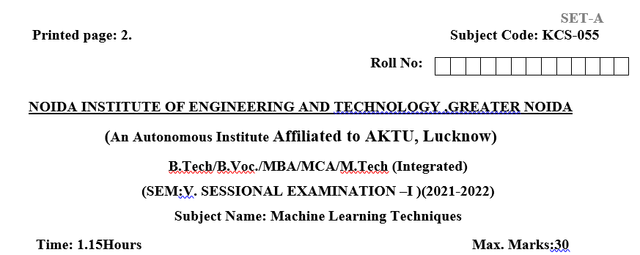
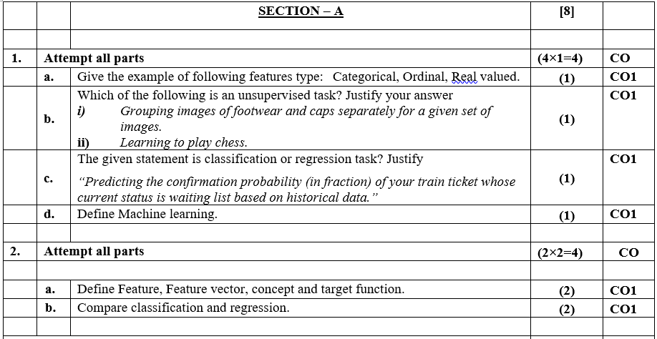
Sessional Question Papers

Slide 103
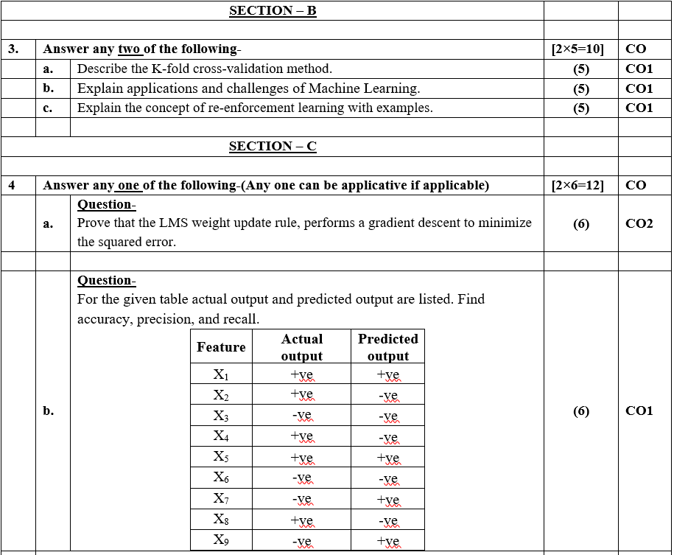
Sessional Question Papers

Slide 104
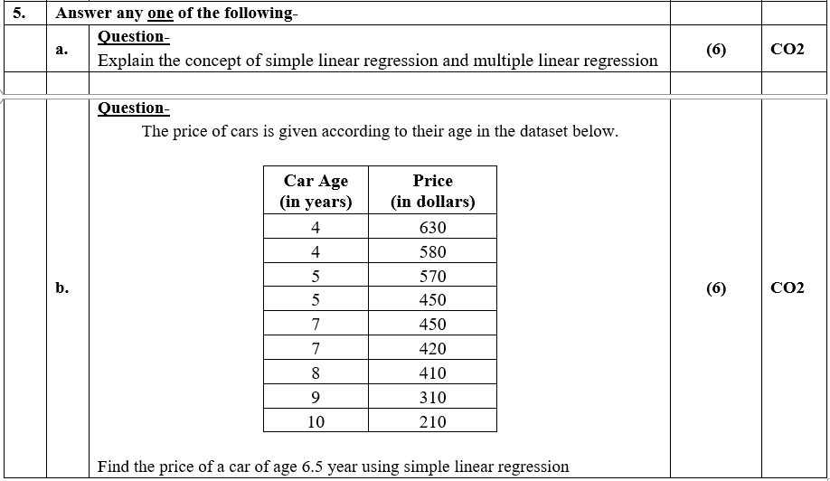
Sessional Question Papers

Slide 105
Expected Questions for University Exam
Explain the various types of issues in machine learning.
Define the learning classifiers.
Explain pruning in decision tree.
Discuss the steps in KNN algorithm and its applications of it.
Explain overfitting and under fitting.
Describe the ID3 Algorithm with a proper example.

Slide 106
Summary
Perceptron training rule guaranteed to succeed if
1. Training examples are linearly separable
2. Sufficiently small learning rate η
Adaline training rule uses gradient descent
Guaranteed to converge to hypothesis with minimum
Given sufficiently small learning rate η

Slide 107
Summary
3. Even when training data contains noise
4. Even when training data not separable by H Problems
Slow convergence to local or global minimum

Slide 108
Glossary Questions
1. Choose correct option
i. Squares ii. Circle iii. Classification
Decision Trees can be used for …………Tasks
chance Nodes are represented by…
c. End Nodes are represented by……
d. Decision Nodes are represented by…..
2. Choose correct option
i) averaging the values of the k nearest neighbours ii )Hamming Distance iii)classification iv) regression
a) distance measure do we use in case of categorical variables in k-NN…
b) When the k Nearest Neighbours algorithm is used for prediction, the values are calculated by----
c) kNN is used for …….problems

Slide 109
Recap
ID3 algorithm
Decision tree
Inductive bias,
Inductive inference with decision trees,
Entropy and information theory, Information gain,
INSTANCE-BASED LEARNING

Slide 110
References
Reference Books:
Introduction to Statistical Learning, Springer, 2013 By Gareth James, Daniela Witten, Trevor Hastie, Robert Tibshirani.
Pattern Classification, 2nd Ed., John Wiley & Sons, 2001, Richard Duda, Peter Hart, David Stork.
Machine Learning, McGraw Hill International Edition, by Tom.M.Mitchell.
Introduction to Machine Learning, Eastern Economy Edition, Prentice Hall of India, 2005 By Ethern Alpaydin.
Pattern Recognition and Machine Learning. Berlin: Springer-Verlag., Bishop, C.

Slide 111
Thank You

